Slide 1
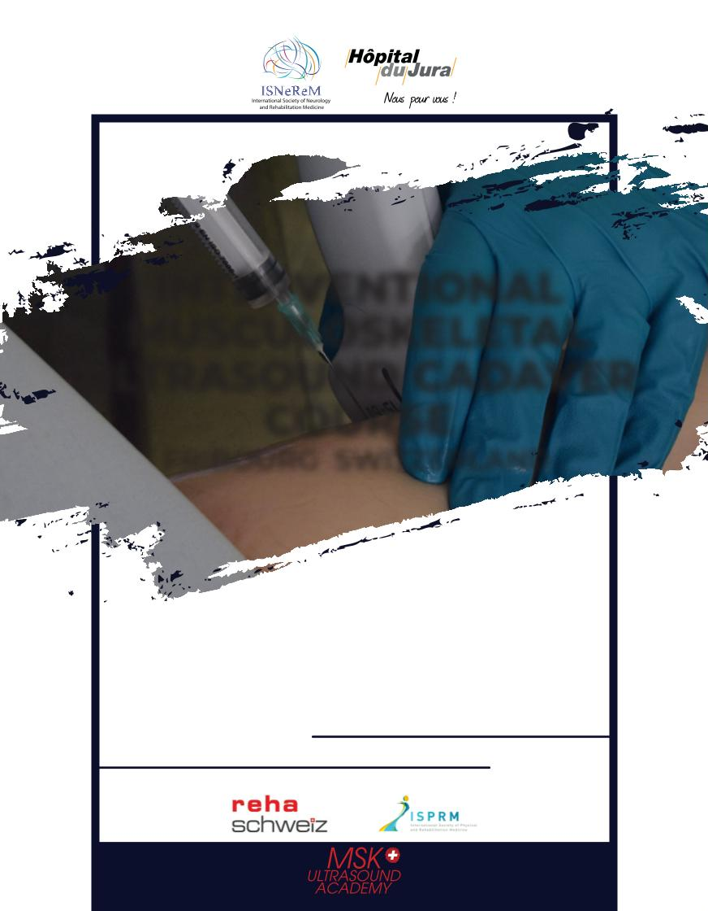
INTERVENTIONAL
MUSCULOSKELETAL
ULTRASOUND CADAVER
COURSE
FRIBOURG SWITZERLAND
Course Director:
Dr. Serdar Koçer
Chair of Anatomy:
Prof. Luis Filgueira
20-21-22 November 2025
Small groups and high tutor to participant ratio
Multidisciplinary faculty
14 CME credits awarded by
Endorsed by
www.mskultrasoundacademy.com

Slide 2




INTERVENTIONAL MUSCULOSKELETAL
14 CME credits
awarded by
This course is
endorsed by
ULTRASOUND CADAVER COURSE
Hours
Plenary Sessions
Anatomy Building / Grand Floor Amphi
Anatomy Building
Anatomy Lab (3rd floor)
09.30.00-11.00
Registration / Welcome and INTRODUCTION
Ultrasound Basic Knobology, Injection Technique Under Ultrasound Guidance
Products Injected (cortisone, anaesthetic, HA, PRP)
Serdar Koçer,
SHOULDER
11.00-12.30
Lunch
13.30-15.00
15.30-17.00
• ANATOMY KEY STRUCTURES-Rotator Cuff Muscles/Tendons, Subdeltoid Bursal,
Acromio Calvicular and Gleno Humeral Joints, Spinoglenoid and Suprascapular
Notches, Suprascapular Nerve
• ELBOW
ANATOMY KEY STRUCTURES-Distal Biceps Tendon, Common Extensor Tendon, Radial
Collateral Ligament, Radiocapitellar Joint, Common Flexor Tendon, Medial Collateral
Ligament, Triceps Tendon, Olecranon Bursal and Ulnar Nerve in Cubital Tunnel
•
Coffee Break
KNEE: ANATOMY KEY STRUCTURES-Quadriceps Muscle/Tendon, Suprapatellar Bursal,Femur, Patella, Joint Lines, Menisci, Medial/Lateral Collateral Ligaments, Patellar Tendon, Tibia, Fibula, Pes Anserine Bursal/Tendons, Distal Iliotibial Band
www.mskultrasoundacademy.com

Slide 3
INTERVENTIONAL MUSCULOSKELETAL
14 CME credits
awarded by
This course is
endorsed by
ULTRASOUND CADAVER COURSE
Hours
Plenary Sessions
Anatomy Building / Grand Floor Amphi
Anatomy Building
Anatomy Lab (3rd floor)
08.00-08.30
INTRODUCTION
Serdar Koçer,
08.30-09.00
09.00-09.30
09.30-12.00
SHOULDER AND ELBOW
• INDICATIONS-Presentation of Indications and Injection Techniques for
Shoulder and Elbow Pathologies
Serdar Koçer,
Coffee Break
SHOULDER
• INJECTION PROCEDURES-Intra-Articular-Acromio Calvicular and Gleno HumeralJoints-Tendinopathy-Biceps Tendon Sheath-Bursal-Subdeltoid Bursal-Pain-Suprascapular Nerve Block
Serdar Koçer, François Droz Bartholet, Andrea Massimiani,Gil Pires Rodrigues, Arnaud Kolly, Rogar Bargoin
12.00-13.00
13.00-14.30
14.30-15.00
15.00-17.30
Lunch
ELBOW
• INJECTION PROCEDURES-Intra-Articular-Radiocapitellar Joint-Tendinopathy-Med/Lat Injections, Triceps Tendon-Bursal-Olecranon Bursal Aspiration/Injection
Serdar Koçer, François Droz Bartholet, Andrea Massimiani,Gil Pires Rodrigues, Arnaud Kolly, Roger Bargoin
Coffee Break
WRIST AND HAND
• INDICATIONS-Presentation of Indications and Injection Techniques for Wrist and
Hand Pathologies
WRIST AND HAND
• INJECTION PROCEDURES-Tenosynovitis-1st Extensor Compartment, Trigger Finger-Neuropathy-Median Nerve in Carpal Tunnel 1st CMC joint, Radio-Carpal Joint
Serdar Koçer, François Droz Bartholet, Andrea Massimiani,Gil Pires Rodrigues, Arnaud Kolly, Roger Bargoin
Gil Pires Rodrigues
www.mskultrasoundacademy.com

Slide 4
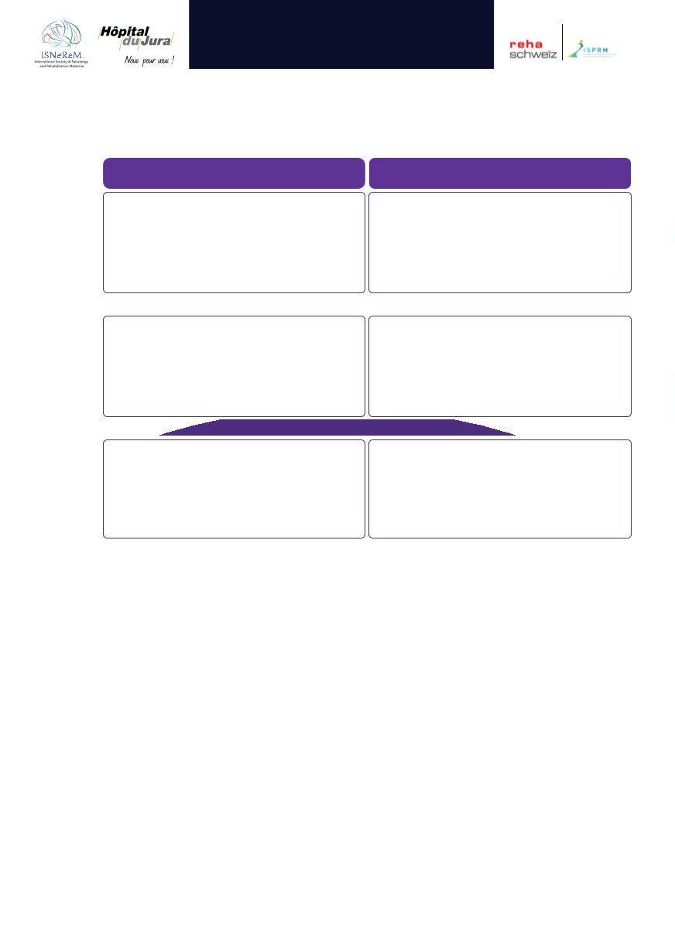
INTERVENTIONAL MUSCULOSKELETAL
14 CME credits
awarded by
This course is
endorsed by
ULTRASOUND CADAVER COURSE
Hours
Plenary Sessions
Anatomy Building / Grand Floor Amphi
Anatomy Building
Anatomy Lab (3rd floor)
HIP
HIP and KNEE
• INJECTION PROCEDURES-Intra-Articular-Hip Joint-Bursal-Trochanteric Bursa,
Iliopsoas Bursal-Tendinopathy-Gluteal Tendon-Myofascial Pain-Piriformis
Serdar Koçer, Omar Khan, François Droz Bartholet, Andrea Massimiani,Gil Pires Rodrigues, Arnaud Kolly , Roger Bargoin
08.30-10.30
10.30-11.00
• INDICATIONS-Presentation of Indications and Injection Techniques for Hip and Knee
Pathologies
François Droz Bartholet
KNEE
,
•
• INJECTION PROCEDURES-Intra-Articular-Suprapatellar Bursal Aspiration/Injec-
tion-Tendinopathy-Quadriceps/Patellar Tendon-Bursal/Cyst-Pes Anserine, Baker’s
Cyst, Distal ITB , Meniscal Cyst
11.00-12.30
12.00-13.00
Serdar Koçer, François Droz Bartholet, Andrea Massimiani,Gil Pires Rodrigues, Arnaud Kolly , Roger BArgoin
ANKLE AND FOOT
• INDICATIONS-Presentation of Indications and Injection Techniques for Ankle and
Foot Pathologies
ANLKE and FOOT INJECTION PROCEDURES-Intra-Articular-Tibiotalar Joint, Subtalar Joint-
Tendinopathy-Tibialis Posterior and Peroneal Tendon Sheaths, Achilles Tendon,
Plantar Fascia, Morton Nevroma
13.00-15.30
Gil Pires Rodrigues
Serdar Koçer, François Droz Bartholet, Andrea Massimiani,Gil Pires Rodrigues, Arnaud Kolly, roger Bargoin
www.mskultrasoundacademy.com

